Slide 1

movies

Slide 2
Name :hossam fayez karam
Section :2
Department :information system
Email :hossamsamsemo22@gmail.com
Gitehub : https://github.com/hfayez/web
Phone :01205586682

Slide 3
Description :
That website will help user to watch movies
The user can download movies
Give some description to evry movies

Slide 4
Functions
registration in our web sit
Download films
Give him the option to search about movies
short description about evry films
Choice the type of movies you wants

Slide 5
Technologies
Use the html
Use css
Use java script
Use php

Slide 6
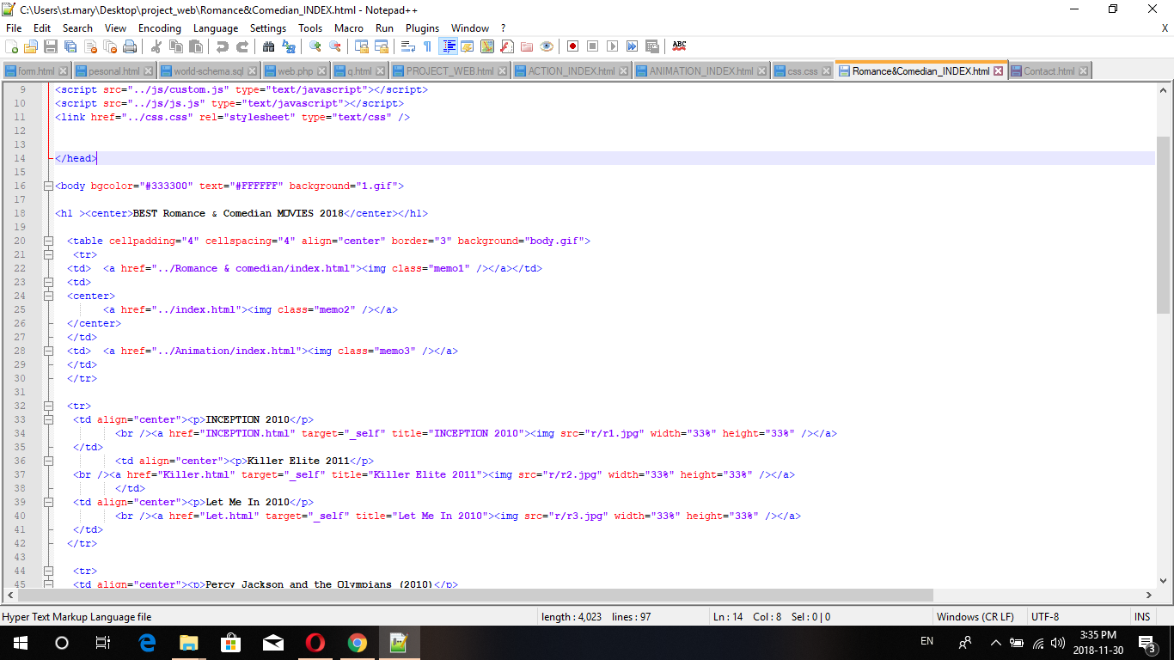

Slide 7
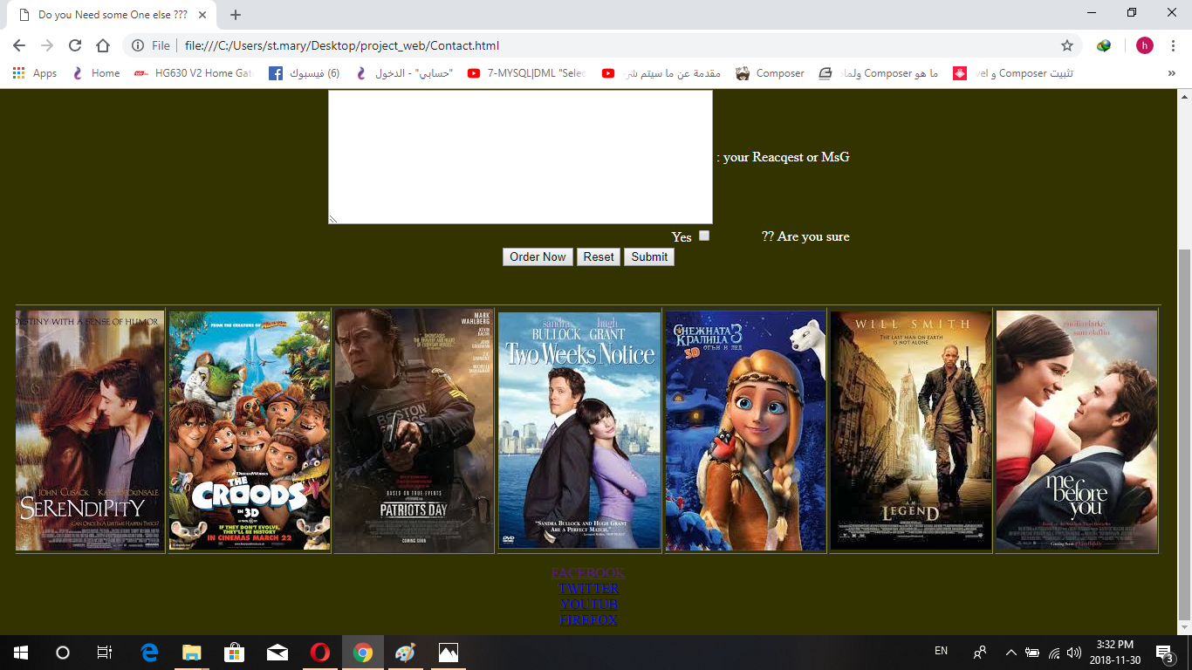

Slide 8
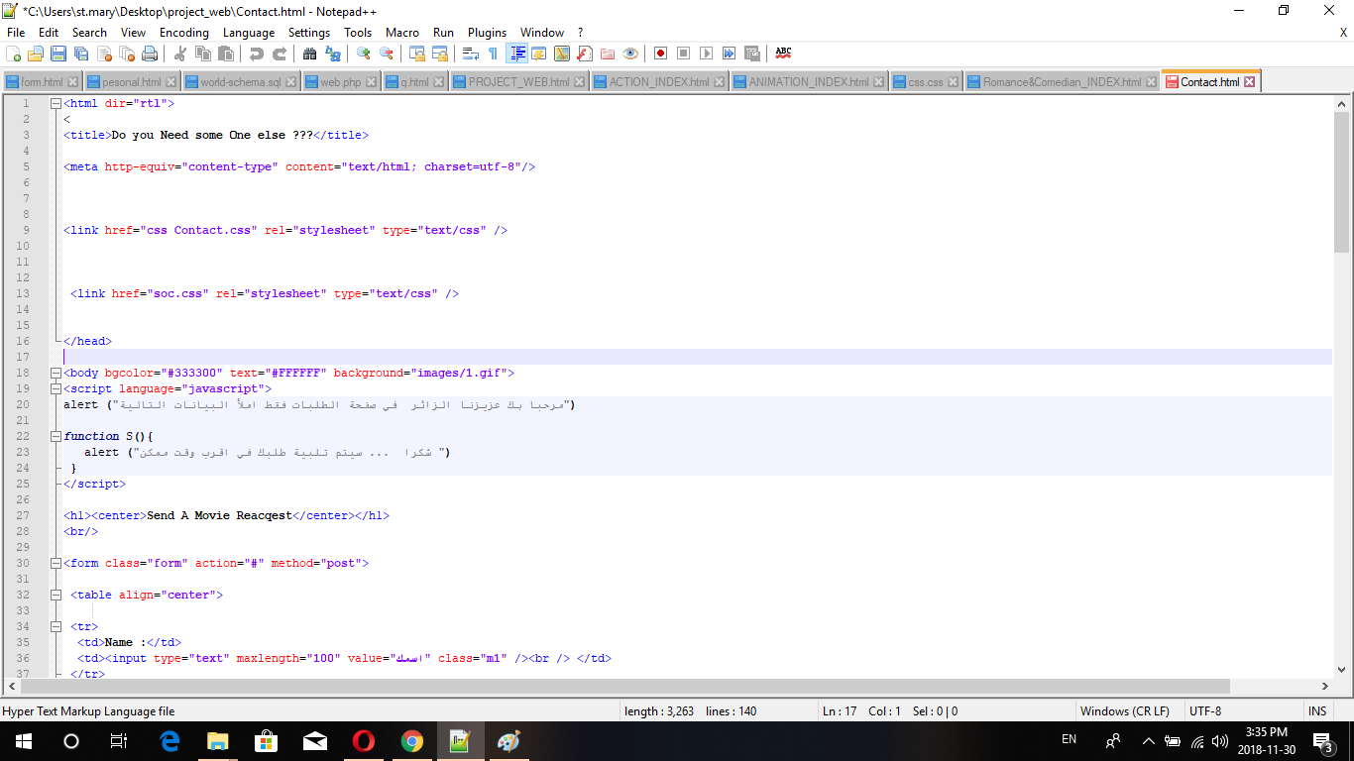

Slide 9
